Slide 1



Control and Automation IC2122 Robotics Lab with VREP
Instructor: Louis Wong
Industrial Centre
The Hong Kong Polytechnic University

Slide 2
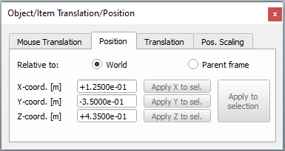
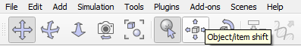
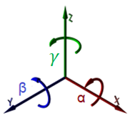
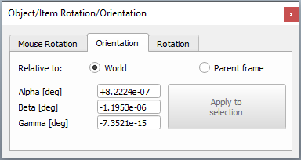
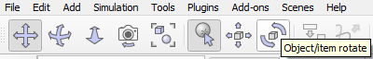

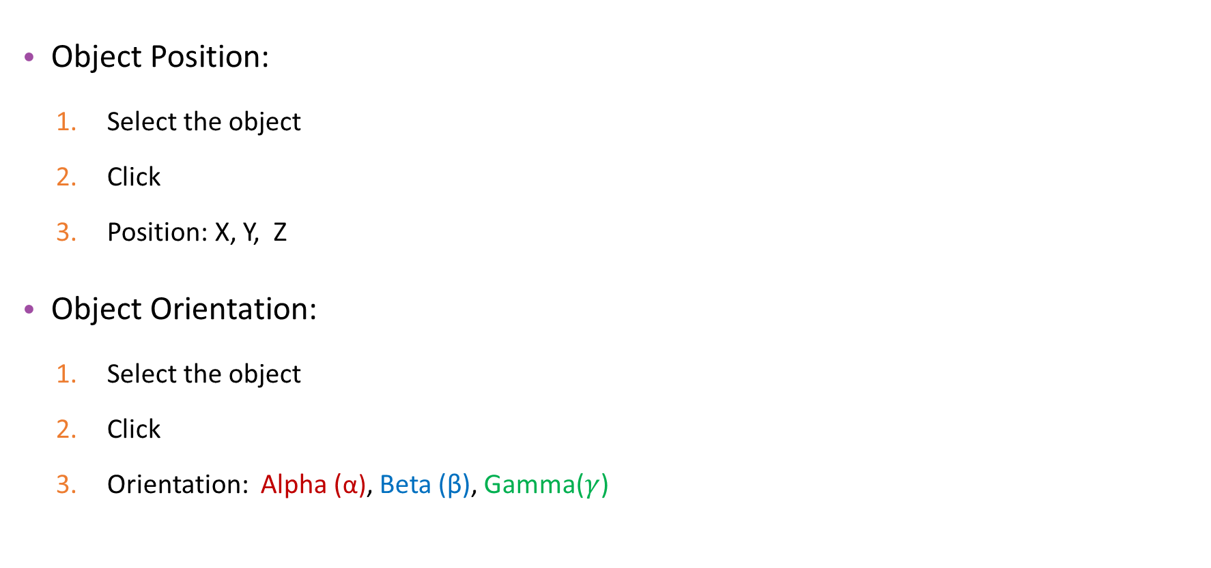
V-REP Tools
Object Position:
Select the object
Click
Position: X, Y, Z
Object Orientation:
Select the object
Click
Orientation: Alpha (α), Beta (β), Gamma($γ$)

Slide 3
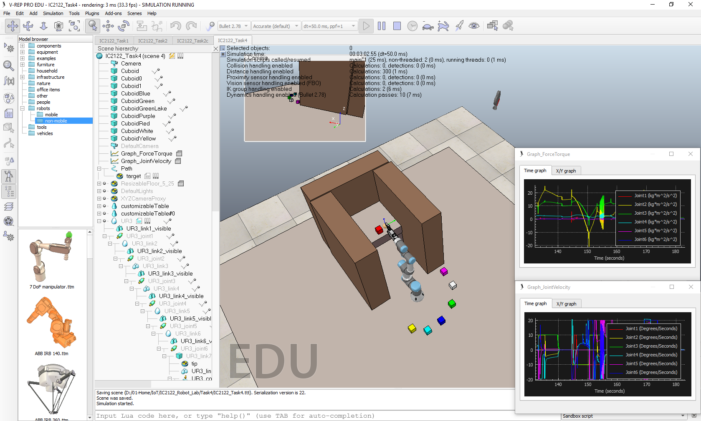
Task 3: Pick and Place

Slide 4
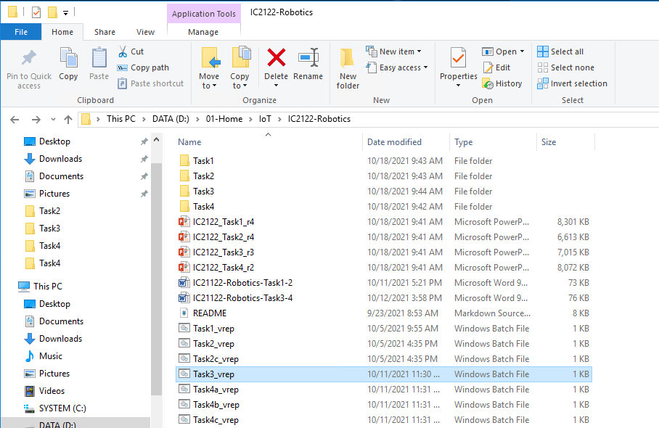
Start-up – V-REP
Start the V-REP (Task3_vrep.bat)
D:\01-Home\IoT\IC2122-Robotics
Double-Click

Slide 5
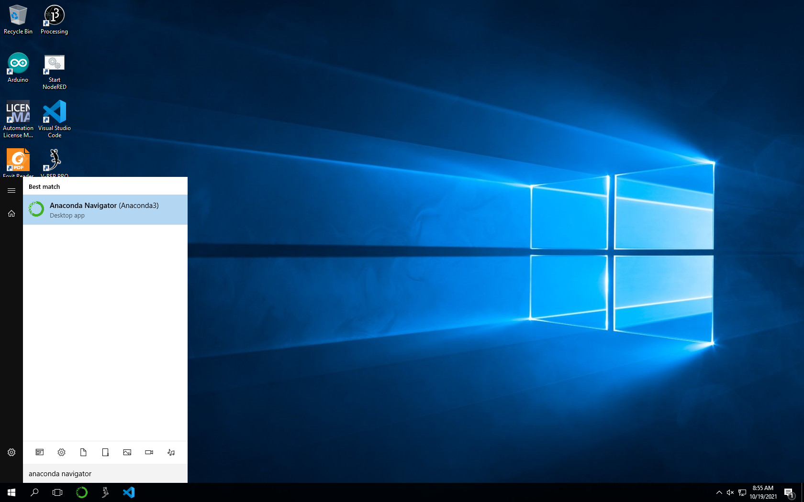
Start-up – Anaconda Navigator
Start the Anaconda Navigator on Taskbar or search Windows
Search Anaconda Navigator and click the icon
OR
Click Anaconda Icon

Slide 6
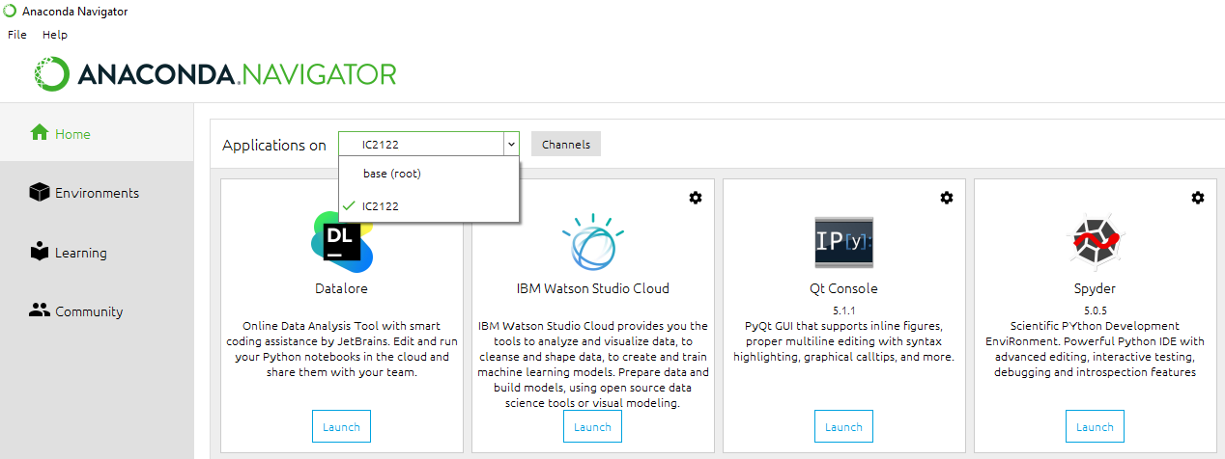
Start-up – Spyder
Launch Spyder
2
1
3
4

Slide 7
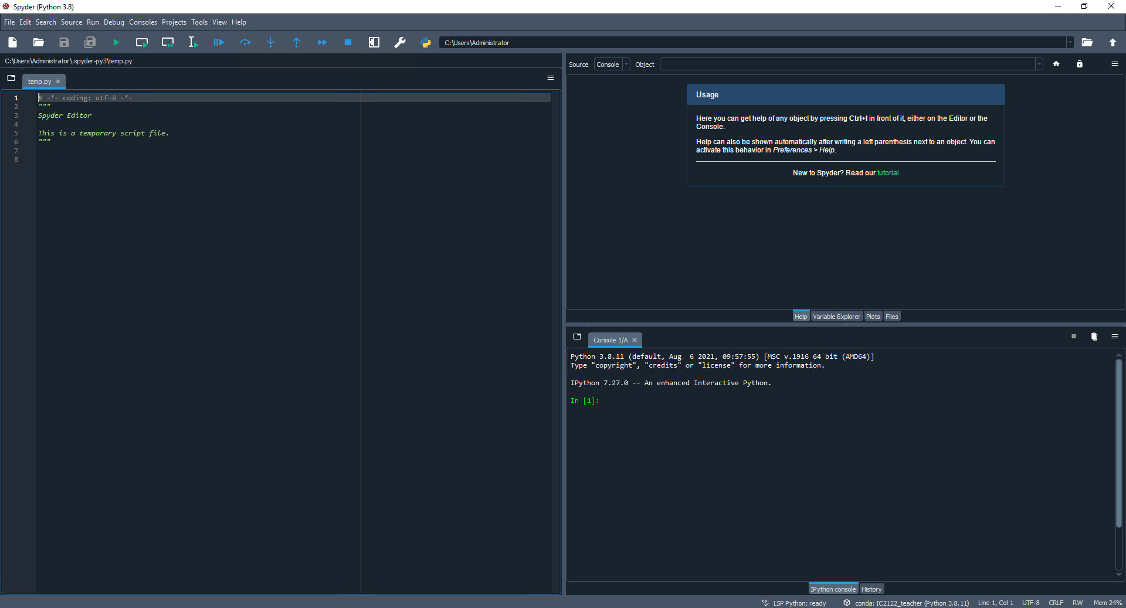
Start-up – Spyder
Toolbar
Help
Editor
IPython Console
Status Bar

Slide 8
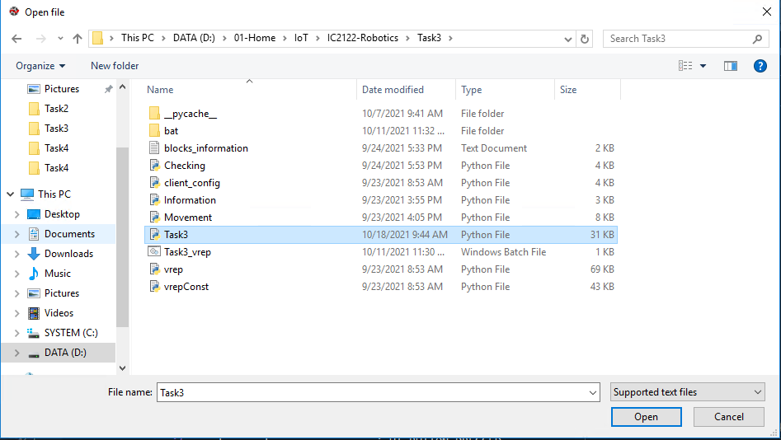
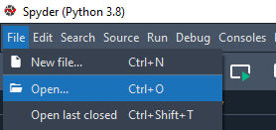

Start-up – Spyder
D:\01-Home\IoT\IC2122-Robotics\Task3
Open Python file at editor
Run the program at Spyder
3
1
2
4
6
5

Slide 9
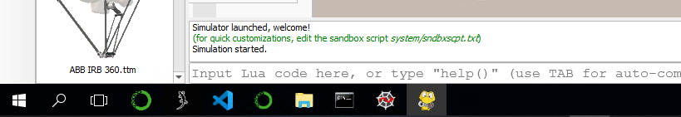
Start-up – Control panel window
Control panel window will be appeared after running the program
After switching to the V-REP, the control panel window will be hidden
Click the Control panel window icon to open it.
Click this icon

Slide 10
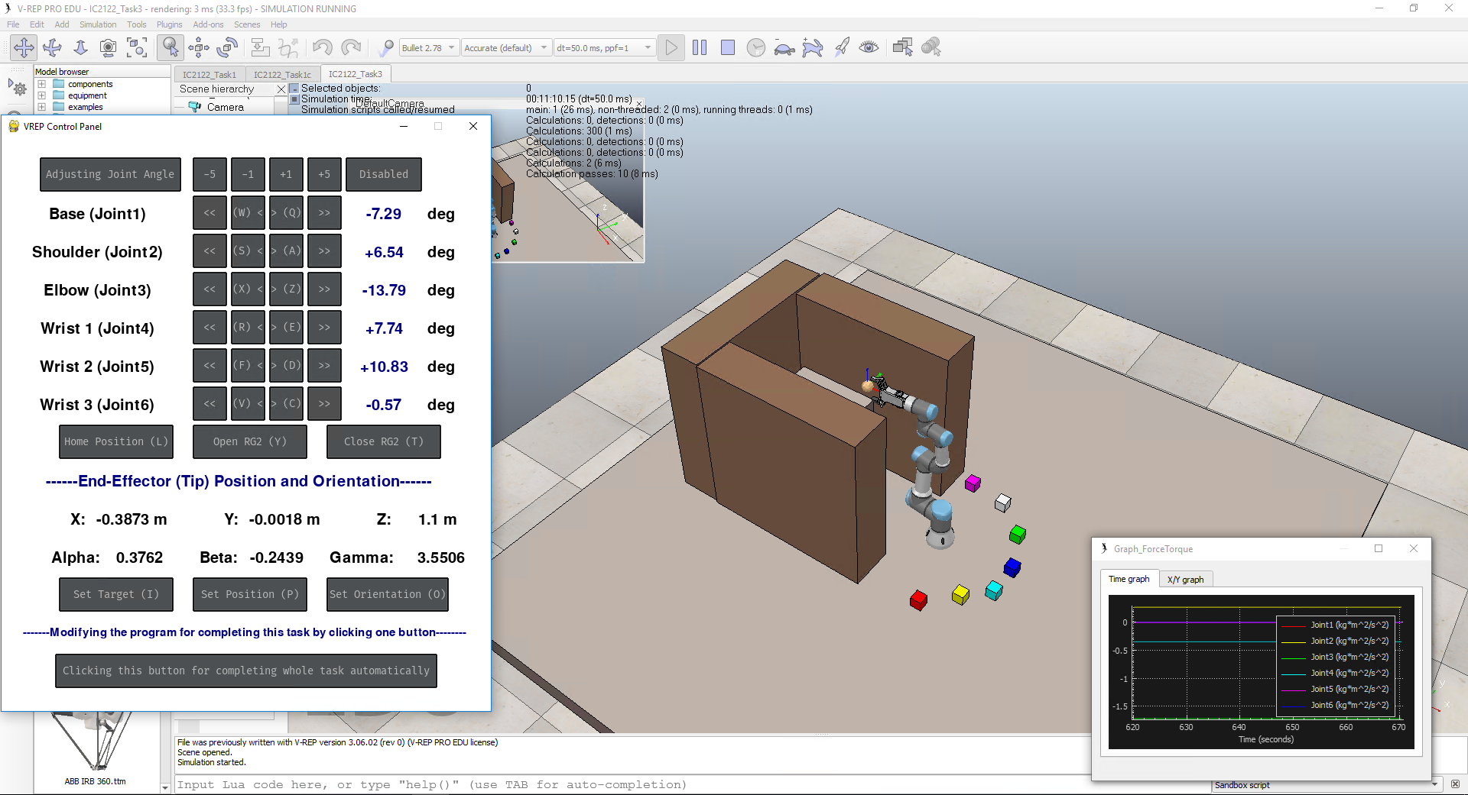
V-REP interface
V-REP interface :

Slide 11
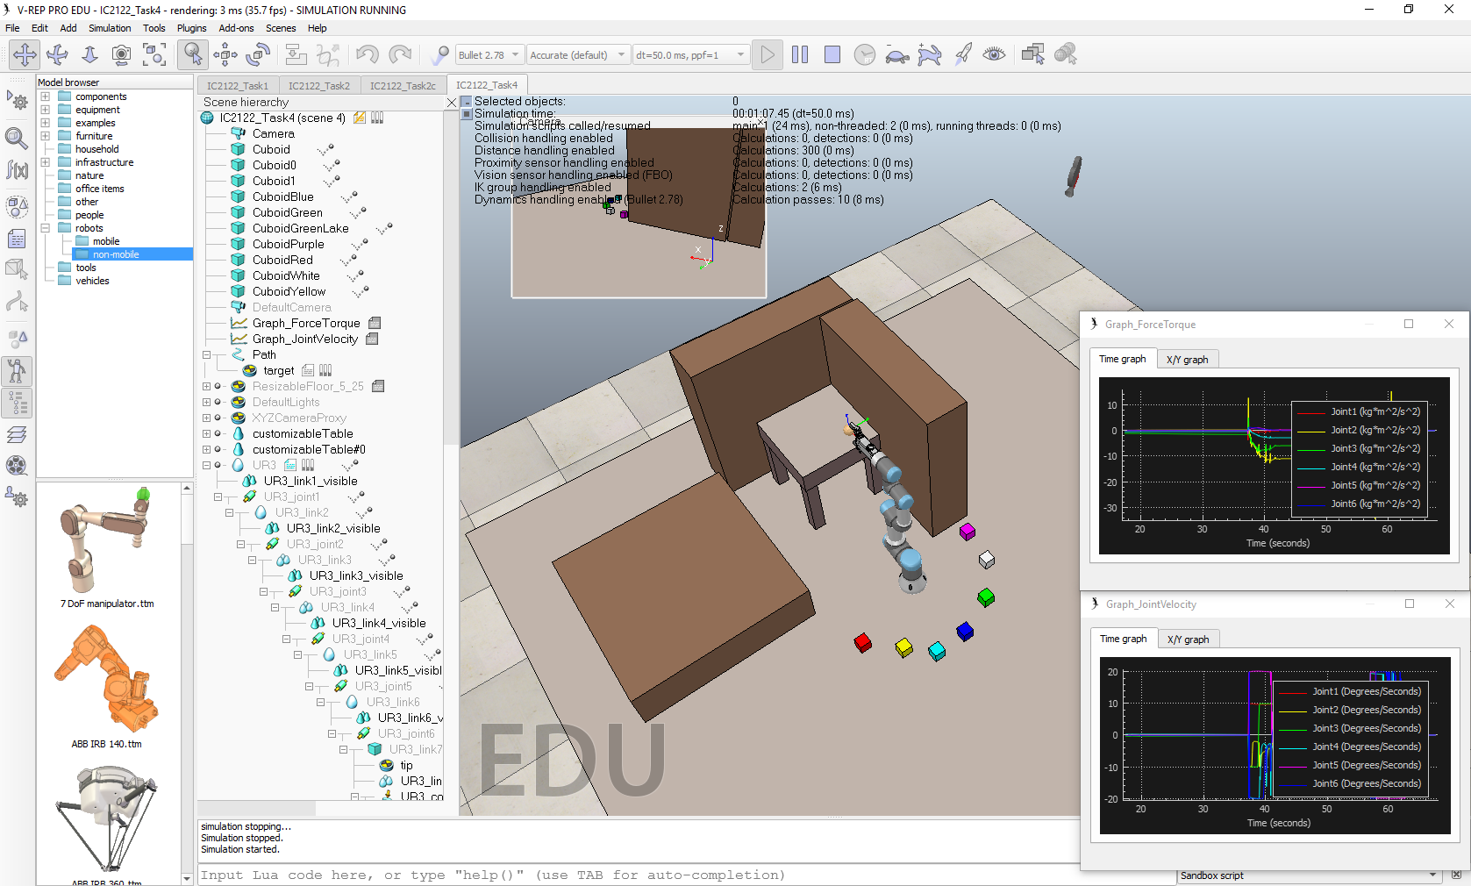
IC2122 – Task 3
Remarks:
No collisions on the
blocks and walls
Not allow to move the blocks via V-REP tools

Slide 12

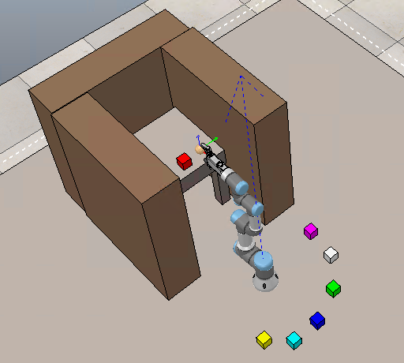
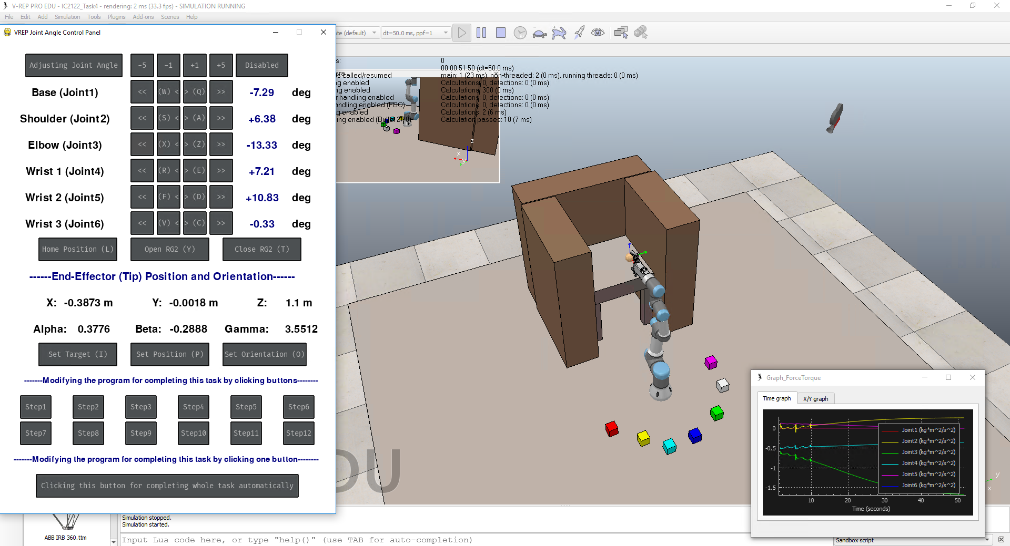
IC2122 – Task 3a
Task 3a: Assume there has a collaborative robot working in the factory. The color blocks are the raw materials which are placed in the machine for process.
Pick the RED block and place it on the table (machine) using Inverse Kinematics for processing and write down the procedure. (Return to the home position at the final step)
(Remark: No collisions)
(Using below button to complete this task)
Final Goal
RED Block original Position: | Position X | Position Y | Position Z
 | 0.125 m | -0.35 m | 0.435 m
RED Block final Position: | Position X | Position Y | Position Z
 | ≈ -0.667 m | ≈ 0 m | 0.846 m

Slide 13
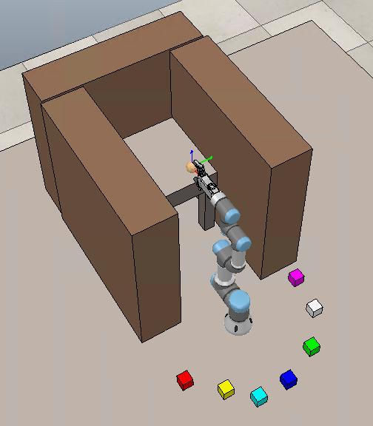
IC2122 – Task 3b
Task 3b: Continuing in part a, the process of material (RED block) is completed. Put it back to the original position.
Pick the RED block from the table (machine) and place it on the original position using Inverse Kinematics and write down the procedure. (Return to the home position at the final step)
(Remark: No collisions)
(Using below button to complete this task)
Final Goal
RED Block original Position: | Position X | Position Y | Position Z
 | ≈ -0.667 m | ≈ 0 m | 0.846 m
RED Block final Position: | Position X | Position Y | Position Z
 | 0.125 m | -0.35 m | 0.435 m

Slide 14
IC2122 – Task 3c
Task 3c: Create a python program to automate the process of raw material by clicking the "Clicking this button for completing whole task automatically" button. Write down the procedure and explain your program.
Pick the RED block and place it on the table (machine)
Return to the Home Position
Pick the RED block from table (machine) and place it on the original position
Return to the Home Position
(Remark: No collisions)
RED Block (table) Position: | Position X | Position Y | Position Z
 | ≈ -0.667 m | ≈ 0 m | 0.846 m
RED Block original Position: | Position X | Position Y | Position Z
 | 0.125 m | -0.35 m | 0.435 m

Slide 15
IC2122 – Task 3c
Modify the Task3.py (Path: D:\01-Home\IoT\IC2122-Robotics\Task3\Task3.py)
Useful command:
Move the end-effector to position (X, Y, Z)
movement.setTargetPosition_withoutInput(PosX, PosY, PosZ)
Configure the end-effector’s orientation (Alpha,Beta,Gamma)
movement.setTargetOrientation_withoutInput(Alpha, Beta, Gamma)
Input the corresponding value at ()
# Please input the necessary command for completing this task by clicking one button
# You can review the comments for seeking the useful functions which are located at other files
# (Movement.py, Information.py, Checking.py)
if event.user_type == pygame_gui.UI_BUTTON_PRESSED:
if event.ui_element == complete_button:
# -----Example start-----
movement.setTargetPosition_withoutInput(0.2,-0.2,0.6) # Move the end-effector to the position X, Y, Z
time.sleep(5) # Delay 5 seconds for waiting the previous movement
movement.setTargetOrientation_withoutInput(0,90,-90) # Configure the end-effector's orientation Alpha, Beta, Gamma
# -----Example End-----
# Please input your command (functions can be found at Task3.py, Movement.py, Information.py, Checking.py )
print("Working........")
Example code for Task 3c

Slide 16
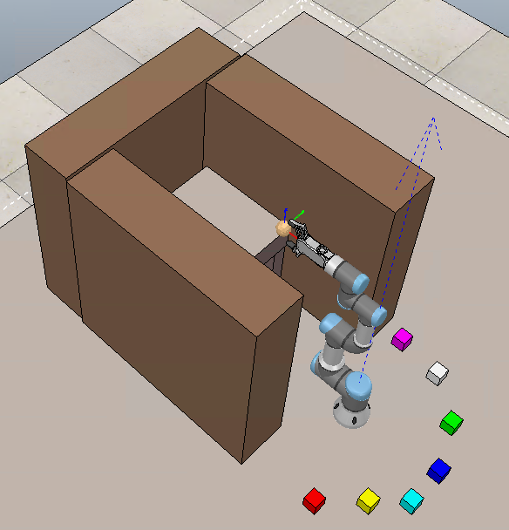
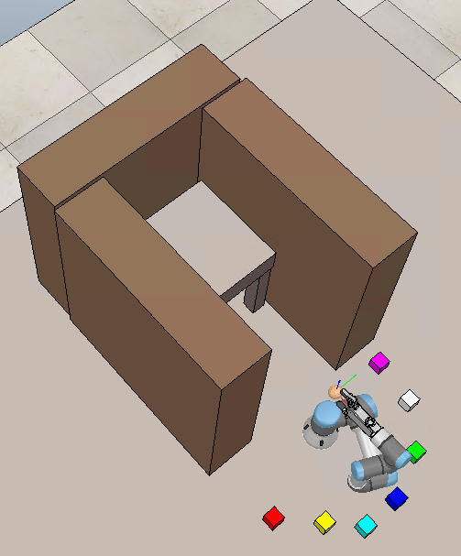
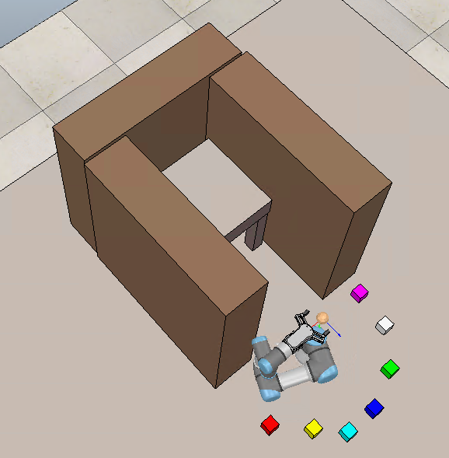
IC2122 – Example
According to previous program:
Step 1: Move the end-effector to the position X, Y, Z
movement.setTargetPosition_withoutInput(0,0,0.8)
Step 2: Delay 10 seconds for waiting the previous movement
time.sleep(10)
Step 3: Configure the end-effector's orientation Alpha, Beta, Gamma
movement.setTargetOrientation_withoutInput(0,90,-90)
Original Pose
Step 1
Step 3

Slide 17
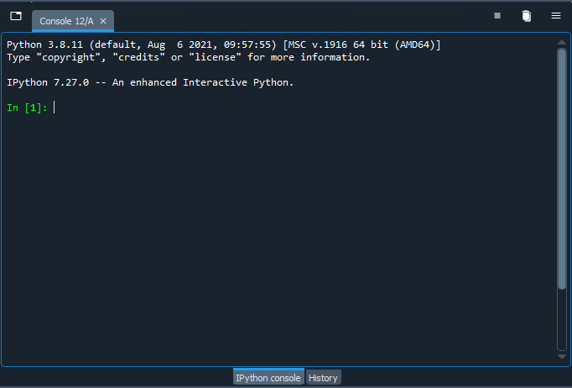
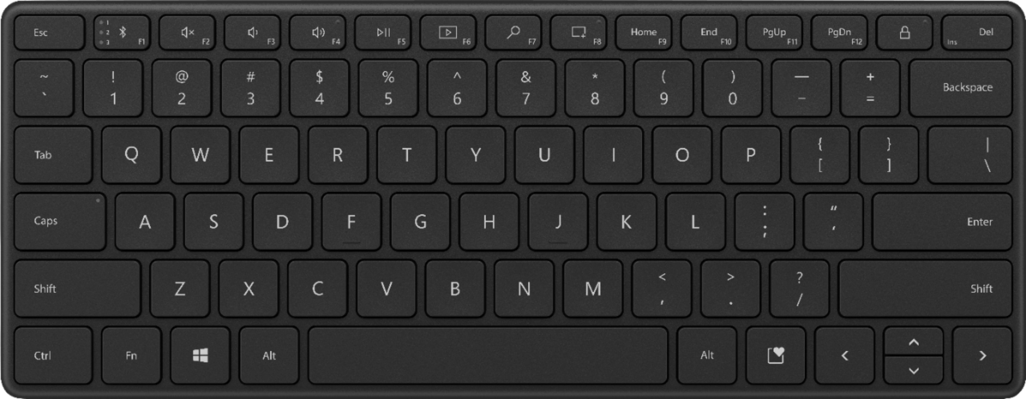
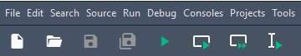
Task3 – Troubleshoot
Step 1: Switch to the Spyder IPython Console
Step 2: Stop the program by pressing “Ctrl + C”
Step 3: Open a new console by pressing “Ctrl + D”
Step 4: Stop the V-REP simulation
Step 5: Run the program at Spyder
Step 1
Step 3
Step 2
Step 4
Step 5

Slide 18
Q&A

